Slide 1
Getting Started With Angular Chapter 3: Modules
Tushar Raj
Gaurav Sharma

Slide 2
Angular Modules

Slide 3
Routing Module
Ingredients:
The <base> tag
(set <base href="/"> in index.html)
Router imports
import { RouterModule, Routes } from '@angular/router';
//
imports: [ RouterModule.forRoot( appRoutes) ],

Slide 4
Routing Configuration
const appRoutes: Routes = [
{ path: 'home', component: HomeComponent },
{ path: 'profile/:id', component: ProfileComponent },
{ path: '', redirectTo: '/home', pathMatch: 'full' },
{ path: '**', component: PageNotFoundComponent }
];
The router uses a first-match wins strategy when matching routes, so more specific routes should be placed above less specific routes.
In the configuration above, routes with a static path are listed first, followed by an empty path route (''), that matches the default route.
The wildcard route (**) comes last because it matches every URL and should be selected only if no other routes are matched first.

Slide 5
Router outlet and links
Ingredients:
<h1>Angular Router</h1>
<nav>
<a routerLink="/home" routerLinkActive="active">Home</a>
<a routerLink="/profile" routerLinkActive="active">Profile</a>
<a routerLink="/signin" routerLinkActive="active">Sign In</a>
<a routerLink="/signup" routerLinkActive="active">Sign Up</a>
</nav>
<router-outlet></router-outlet>

Slide 6
Forms Module
Angular has two approaches to building forms:
Template-driven forms: Easier to create, but not as robust. Useful when a basic form is needed.
Reactive forms: More scalable and reusable. Useful for important, feature-rich forms.

Slide 7
ngModel
A name property is required by Angular forms to register the control with the form.
Defining a name property is mandatory when using [(ngModel)] in combination with a form.

Slide 8
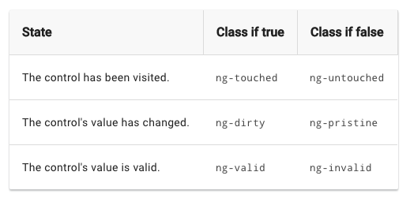
ngModel

Slide 9
ngForm
Angular automatically creates and attaches an NgForm directive to the <form> tag
The NgForm directive supplements the form element with additional features.
It also has its own valid property which is true only if every contained control is valid.

Slide 10
HTTP Module

